Slide 1
Study in Holland: open to international minds
Nuffic | Neso Turkey
November 2018
Merve Kalyoncu
Chief Representative Officer

Slide 2
Content
Holland impressions
Why study in Holland?
Dutch Education System
Practical information

Slide 3
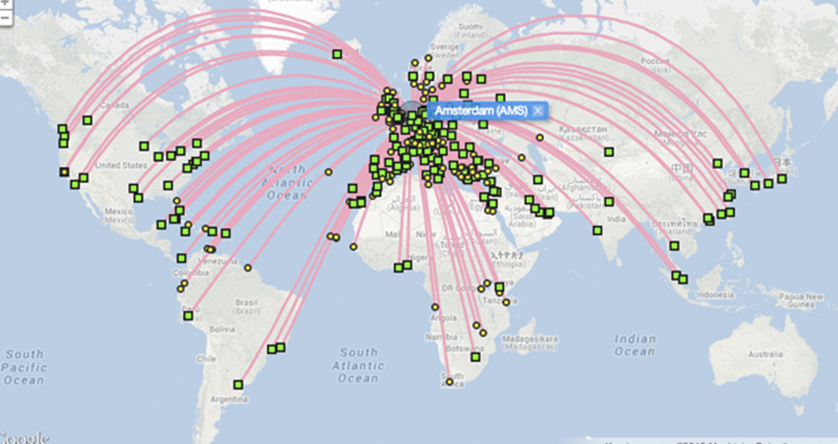
Why study in Holland?
Small country, big opportunities
International study environment
Excellent education & research
Interactive way of teaching
Value for money

Slide 4
International study environment
Leading in number of international study programmes
2,100 English-taught study programmes in more than 30 cities
International study environment
over 112,000 international students
1446* Turkish students
*Nuffic Statistics 2018

Slide 5
Excellent education and research
Strong reputation worldwide: 8 Top 100 institutions in
Times Higher Education World Rankings 2017
13 Dutch higher education institutions in the Top 200
Rankings THE 2018
10 Dutch higher education institutions in the Top 200
World University Rankings 2016-2017 (QS)

Slide 6
More examples
10 Dutch Higher Education Institutions in the Top 200 Academic Ranking of World Universities Shanghai 2017
9 Dutch Higher Education Institutions in the Top 200 University Ranking by Academic Performance URAP 2017-2018
13 Dutch Higher Education Institutions in the Top 200 Rankings CWTS Leiden Ranking Academic Ranking 2017
These lists are applicable to YÖK

Slide 7
Excellent teaching and industry links
Universities of applied sciences
practical application of arts and sciences
professional study programmes
workplacement / internships
National rankings http://www.webometrics.info/ http://www.eurogates.nl/national-rating-netherlands-universities-applied-sciences/

Slide 8
The way of teaching
Way of teaching
Respect for individual´s opinion
Interactive
Problem-based learning
International classroom

Slide 9
Value for money
Tuition fees
Not free, but reasonable
Bachelor
Tuition fee (average): € 6,000 – € 15,000
Master
Tuition fee (average): € 8,000 – € 20,000
Payment schemes

Slide 10
Dutch higher education system
Research Universities
Academic study and research
Universities of Applied Sciences
Practical application of knowledge
Institutes of International Education
Focus on development oriented courses in small, intercultural groups
Bologna Process
ECTS points (European Credit Transfer and Accumulation System)

Slide 11
Bachelor degrees
Research Universities
Academic study/research
3 years
Degree: Bachelor of Arts (BA) / Bachelor of Science (BSc)
University of Applied Sciences
Practically oriented
4 years
Degree: Bachelor (B) + field of study

Slide 12
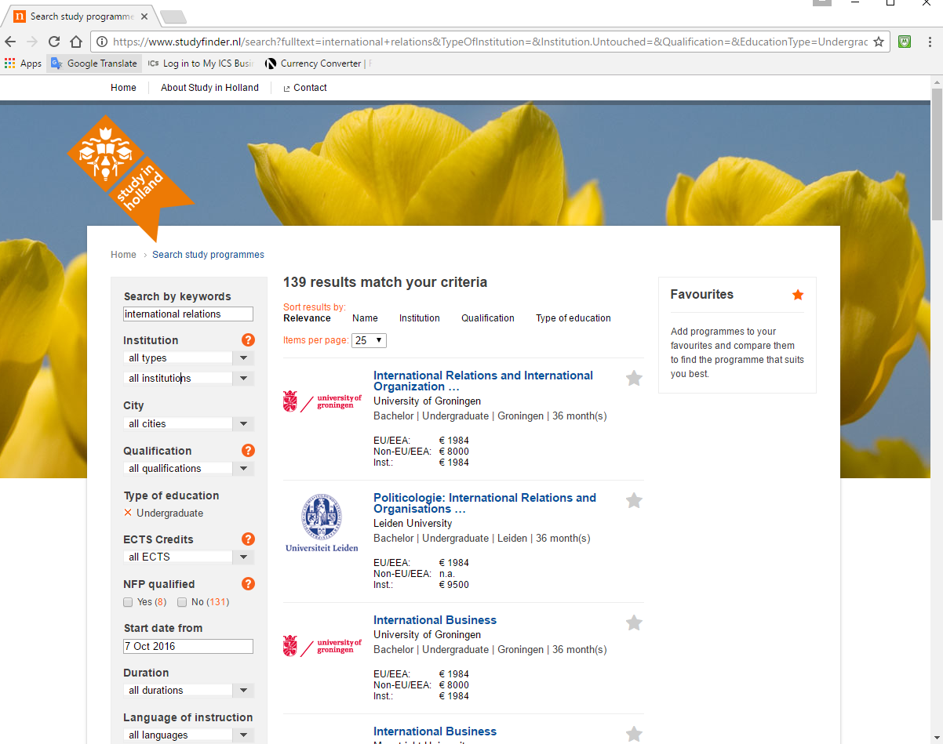
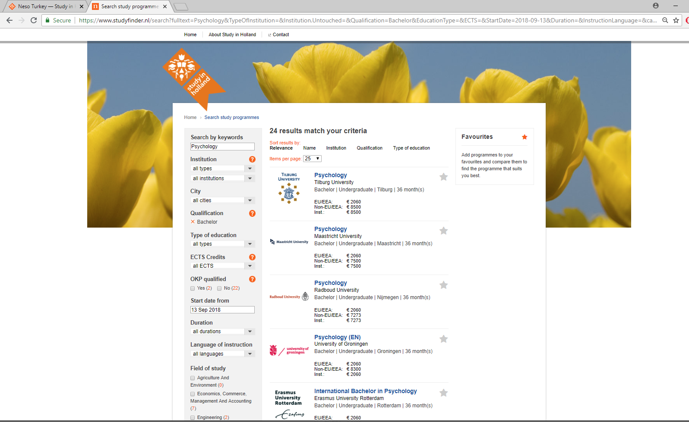
studyfinder.nl Bachelor programmes in the Netherlands
International Relations
218 results
Psychology
24 results

Slide 13
Scholarships
Scholarships offered by the Dutch government or private institutions
The Holland Scholarship www.studyinholland.nl/hollandscholarship - Deadlines 1 February & 1 May 2018
NN Future Matters Scholarship https://www.studyinholland.nl/scholarships/highlighted-scholarships/nn-future-matters-scholarship - Deadline 3 April 2018
Scholarships offered by Dutch higher education institutions
Maastricht University SBE Turkey Scholarship
Amsterdam Excellence Scholarships
CentER Scholarships Tilburg University
Leiden University Excellence Scholarship programme
Zuyd University of Applied Science
Scholarships offered in your own country
Tübitak: Yurtdışı Doktora Sonrası Araştırma Burs Programları
Jean Monnet Scholarship Programme

Slide 14
grantfinder.nl Scholarships available for Turkey

Slide 15
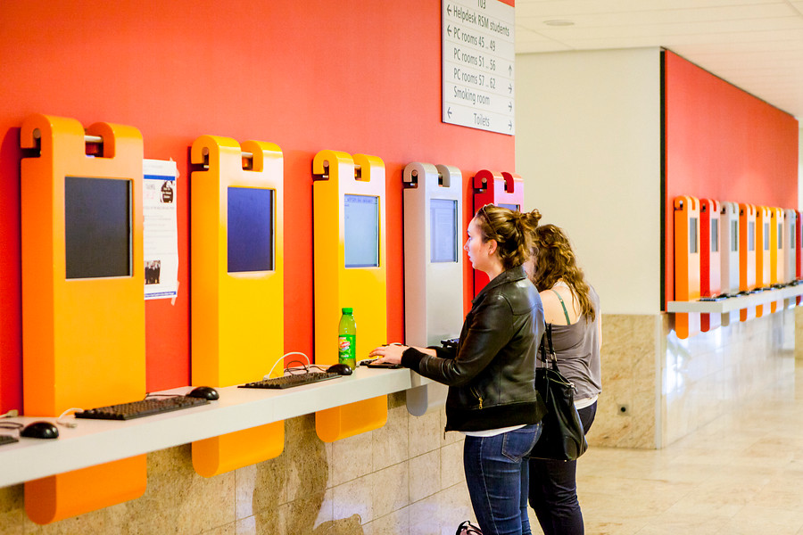
General requirements
Transcript
IELTS / TOEFL
Motivation letter

Slide 16
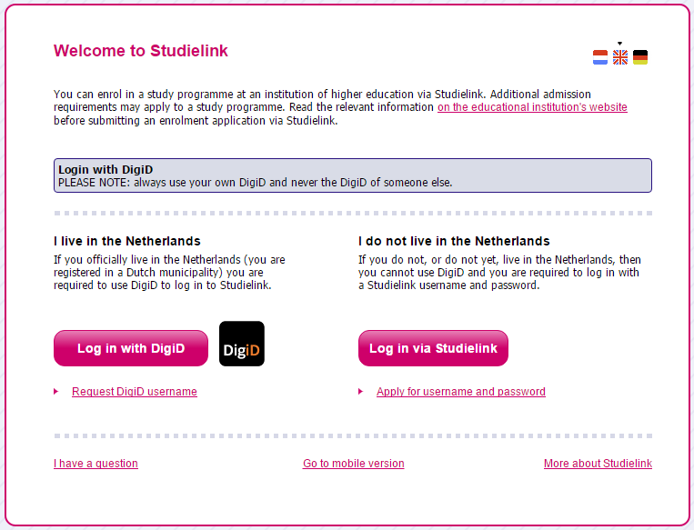
Studielink
Studielink allows you to independently arrange your enrolment and or re-enrolment at your institution of higher education online.
Only for Bachelor and Master degrees
Exchange students apply via their host institution

Slide 17
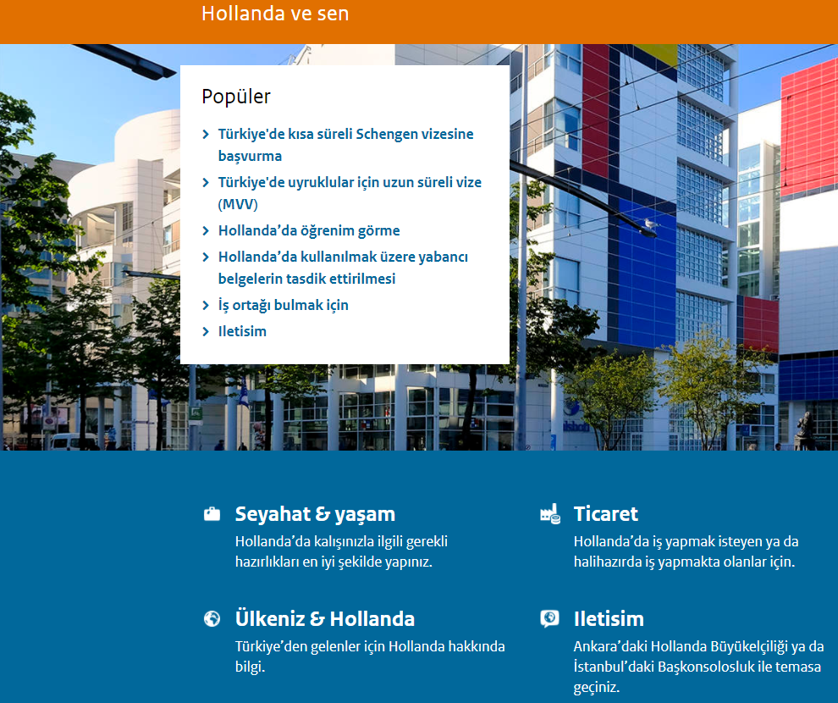
Visa & formalities
To stay longer than 90 days
you need;
an entry visa (MVV)
residence permit (VVR)
Support of host institution
Schengen area
Application fee: €300
(subject to change)
www.hollandavesen.nl/seyahat-ve-yasam/

Slide 18
Health insurance
Everybody in the Netherlands must have insurance for medical costs
Please inform at the international office of your host institution and check what type of insurance applies for you

Slide 19
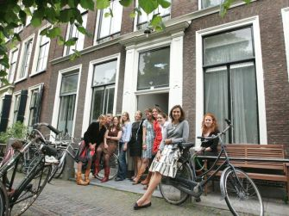
Housing / Accommodation
Options
In a student room: a shared house
On-campus
Cost of housing monthly
€ 300 - € 700 – depends on the city
Recommendations
Start looking for a room as soon as possible
Use the assistance of the institution
https://www.studyinholland.nl/practical-matters/housing

Slide 20
Working while studying
Work permit
Can I work while studying: YES!
Work permit required
Limited number of hours: maximum 16 hours a week
Work full time during summer months
Work after your studies: Orientation Year
Application within 3 years after graduation or finishing research
Application per degree
Top 200 world universities

Slide 21
Important links!
Neso Turkey: www.nesoturkey.org acts as a portal!
Study in Holland: www.studyinholland.nl
English taught study programmes: www.studyfinder.nl
Scholarships: www.grantfinder.nl
Studielink: www.studielink.nl

Slide 22
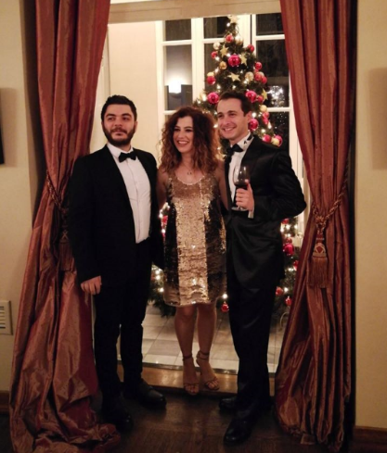
Your local office in Turkey
Nuffic Neso Turkey Team
Call Centre Hours
10:00 – 12:00 14:00 – 16:00
(weekdays)
Tel: +90 212 252 9712
Email: info@nesoturkey.org
Web: www.nesoturkey.org

