Slide 1
Study in Holland
Open to International minds

Slide 2
Content
Holland impressions
Why study in Holland?
Dutch Education System
Practical information

Slide 3

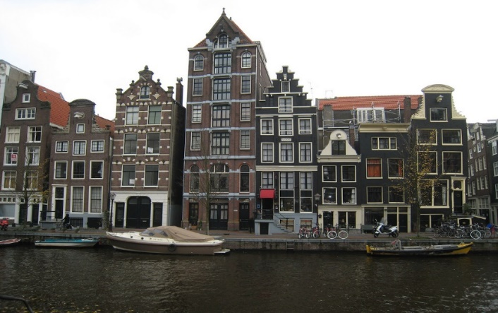
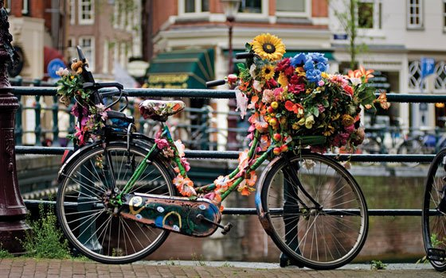

Holland

Slide 4
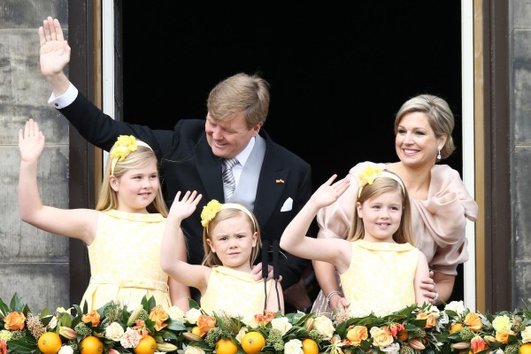
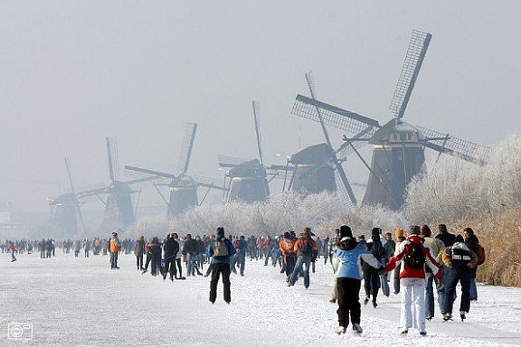
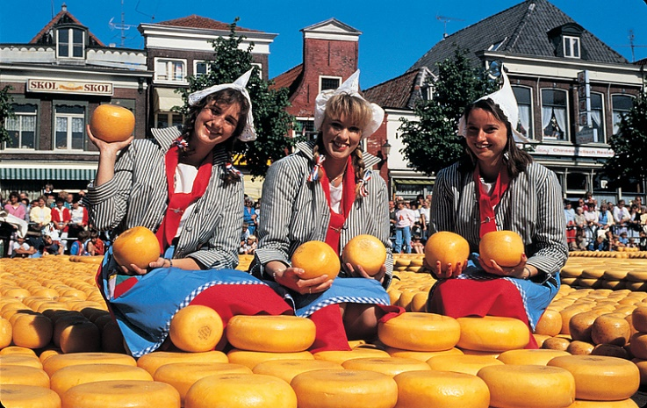
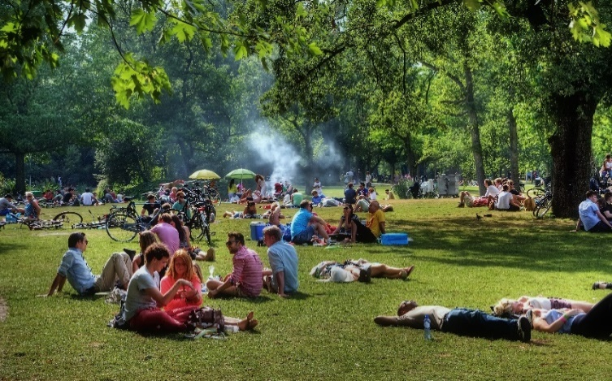
The people

Slide 5
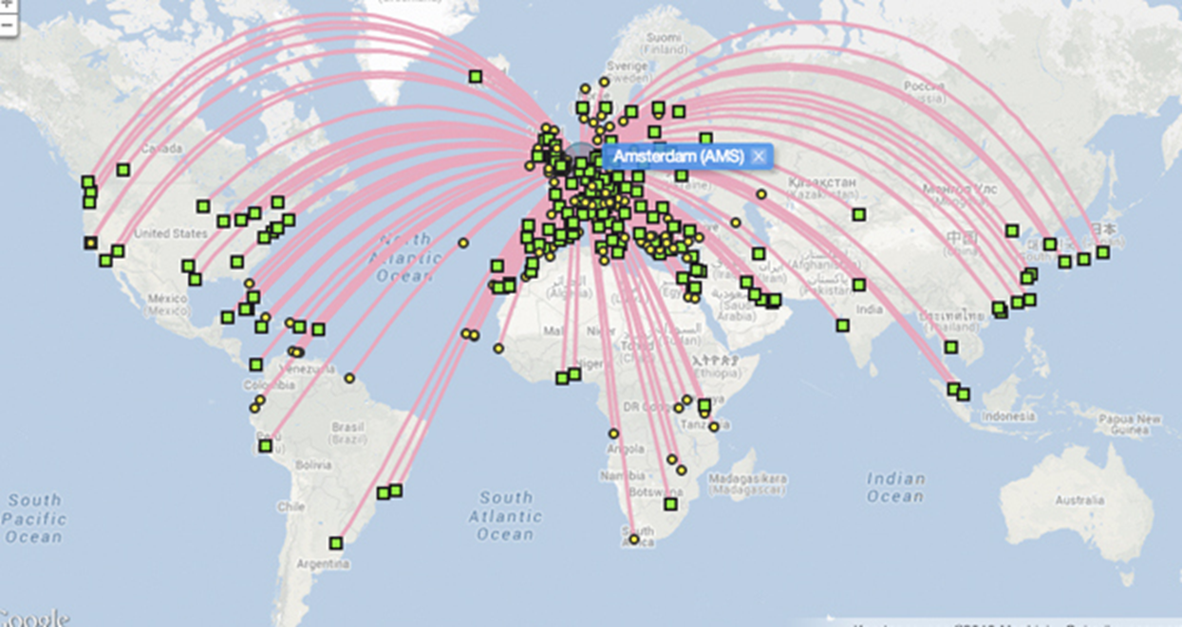
Why study in Holland?
Small country, big opportunities
International study environment
Excellent & innovative education & research
Interactive way of teaching
Value for money

Slide 6


International study environment
Leading in number of international study programmes
2,100 English-taught study programmes in more than 30 cities
International study environment
over 112,000 international students
1446* Turkish students
*Nuffic Statistics 2018

Slide 7

Value for money
Tuition fees
Not free, but reasonable
Bachelor
Tuition fee (average): € 6,000 – € 15,000
Master
Tuition fee (average): € 8,000 – € 20,000

Slide 8
Excellent education and research
Strong reputation worldwide: 7 Top 100 institutions in
Times Higher Education World Rankings 2019-20
13 Dutch higher education institutions in the Top 250
Rankings THE 2019
8 Dutch higher education institutions in the Top 200
World University Rankings 2019 (QS)

Slide 9
More examples
8 Dutch Higher Education Institutions in the Top 200 Academic Ranking of World Universities Shanghai 2019
8 Dutch Higher Education Institutions in the Top 200 University Ranking by Academic Performance URAP 2019
8 Dutch Higher Education Institutions in the Top 200 Rankings CWTS Leiden Ranking Academic Ranking 2019
These lists are applicable to YÖK

Slide 10
Excellent teaching and industry links
Universities of applied sciences
practical application of arts and sciences
professional study programmes
workplacement / internships
National rankings
http://www.webometrics.info/
http://www.eurogates.nl/national-rating-netherlands-universities-applied-sciences/

Slide 11

The way of teaching
Way of teaching
Respect for individual´s opinion
Interactive
Problem-based learning
International classroom

Slide 12
Dutch higher education system
Research Universities
Academic study and research
Universities of Applied Sciences
Practical application of knowledge
Institutes of International Education
Focus on development oriented courses in small, intercultural groups
Bologna Process
ECTS points (European Credit Transfer and Accumulation System)

Slide 13
Bachelor degrees
Research Universities
Academic study/research
3 years
Degree: Bachelor of Arts (BA) / Bachelor of Science (BSc)
University of Applied Sciences
Practically oriented
4 years
Degree: Bachelor (B) + field of study / Bachelor of Science (BSc)

Slide 14
Master degrees
Research Universities
Academic study/research
Master of Arts(MA):1-2 years
Master of Science(MSc):1-2 years
Access to a PhD
University of Applied Sciences
Practically oriented
Master (M): 1-2 years

Slide 15

PhD
Spending a minimum of four years conducting original research and writing a dissertation
Not regarded as a study, but as serious research
Often in paid employment
Some useful websites
www.promodoc.eu
www.academictransfer.com

Slide 16
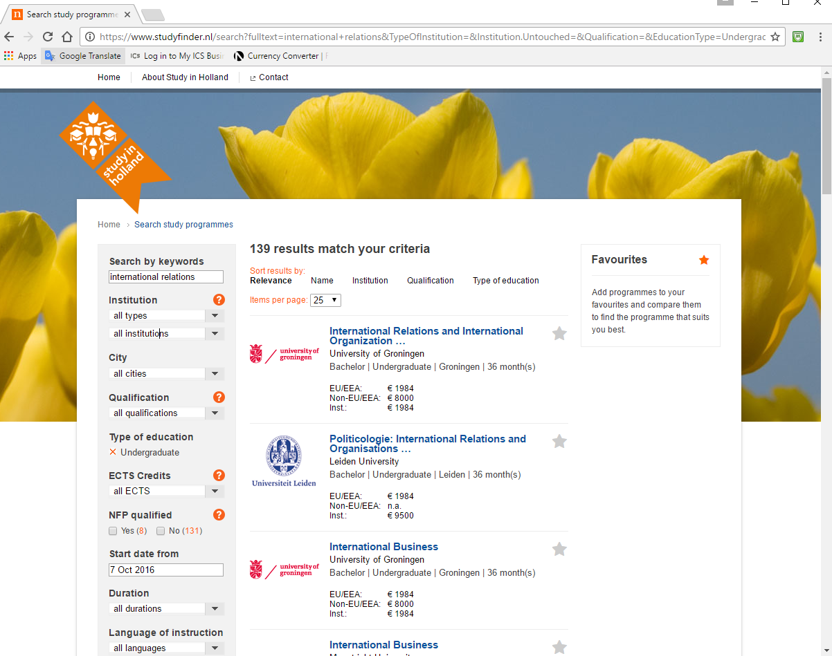
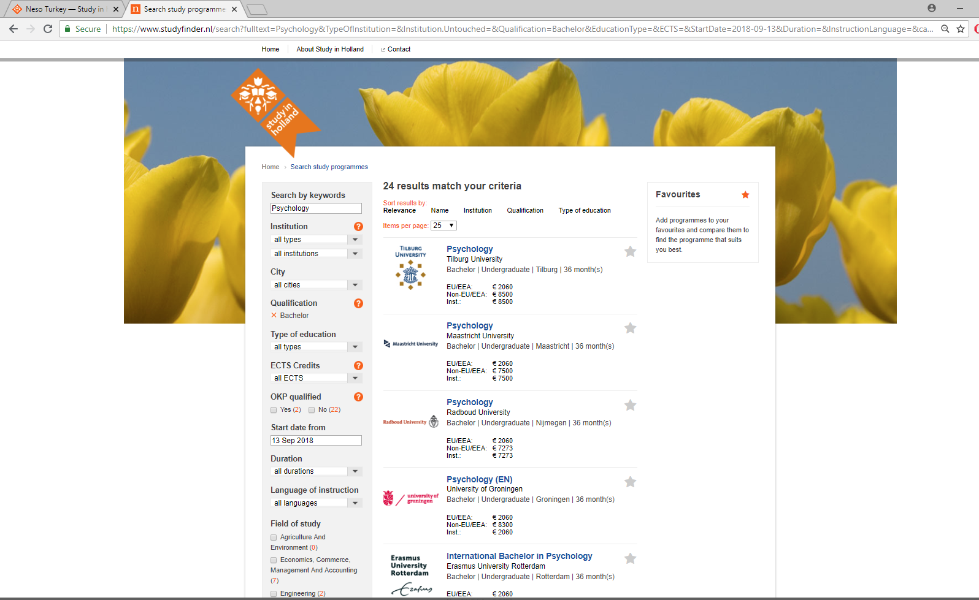
studyfinder.nl
Bachelor programmes in the Netherlands
International Relations
218 results
Psychology
24 results

Slide 17
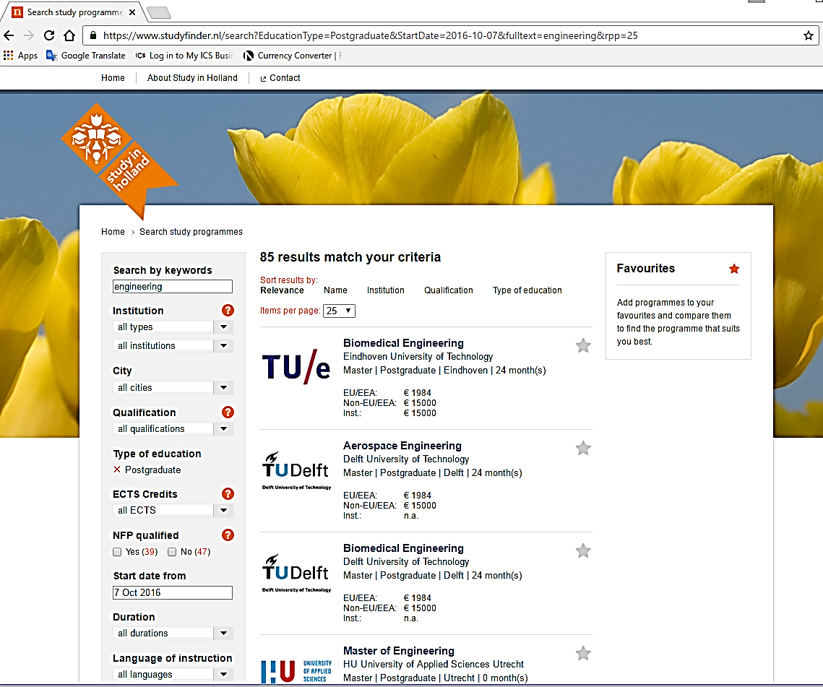
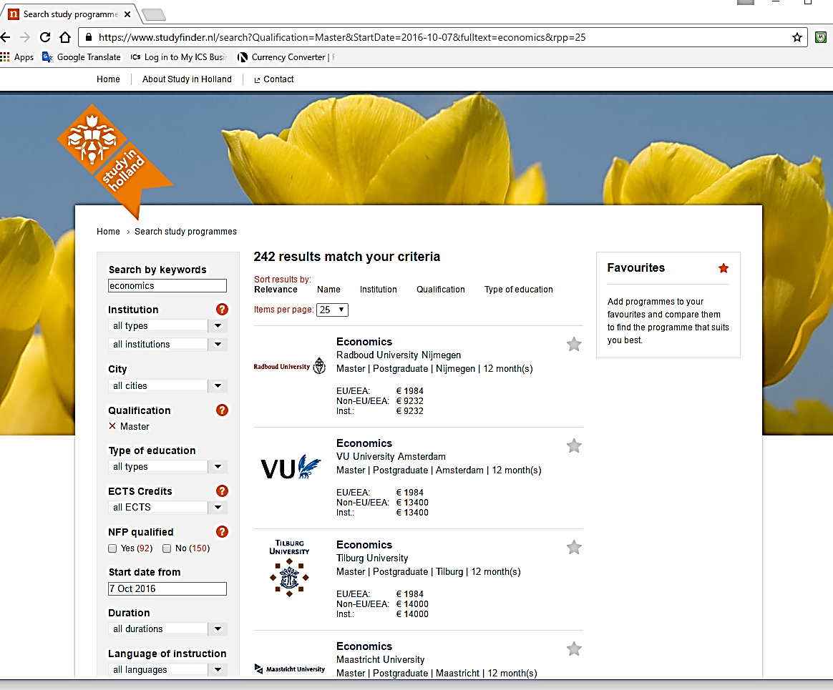
studyfinder.nl
Master programmes in the Netherlands
Engineering
160 results
Economics
358 results

Slide 18
Scholarships
Scholarships offered by the Dutch government or private institutions
  The Holland Scholarship
  www.studyinholland.nl/hollandscholarship - Deadlines 1 February & 1 May 2020
  NN Future Matters Scholarship
  https://www.studyinholland.nl/scholarships/highlighted-scholarships/nn-future-matters-scholarship - Deadline 3 April 2020
Scholarships offered by Dutch higher education institutions
  Maastricht University SBE Turkey Scholarship
  Fontys University of Applied Sciences Top-Talent scholarships for Technology & Business
  CentER Scholarships Tilburg University
  JADS JMJ Scholarships (cooperation Eindhoven University of Technology and Tilburg University) for excellent students in Data Science
  Leiden University Excellence Scholarship programme
  ALSP - Eindhoven University of Technology
Scholarships offered in your own country
  Tübitak: Yurtdışı Doktora Sonrası Araştırma Burs Programları
  Jean Monnet Scholarship Programme
  Milli Eğitim Bakanlığı Bursları

Slide 19
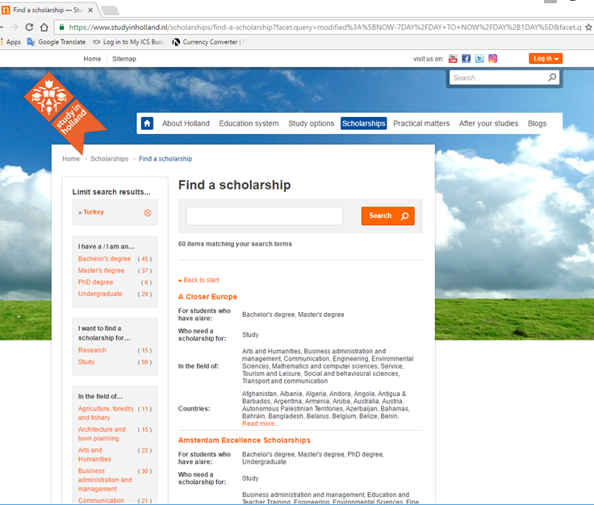
grantfinder.nl
Scholarships available for Turkey

Slide 20
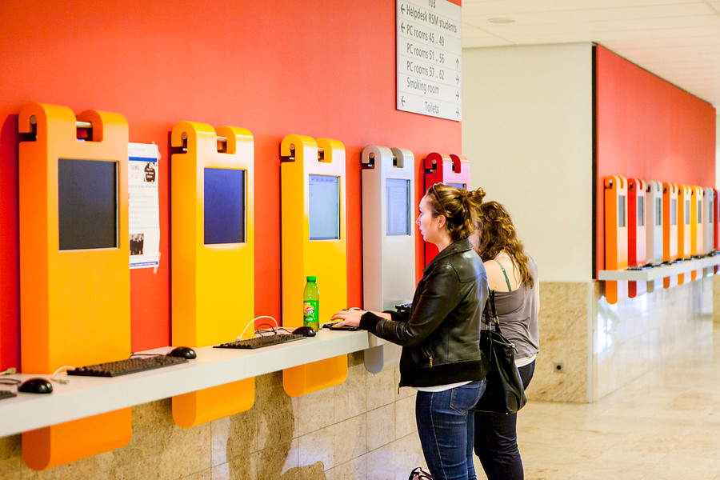
General requirements
Transcript
IELTS / TOEFL
Motivation letter
Subject Exams
Reference Letter
CV

Slide 21
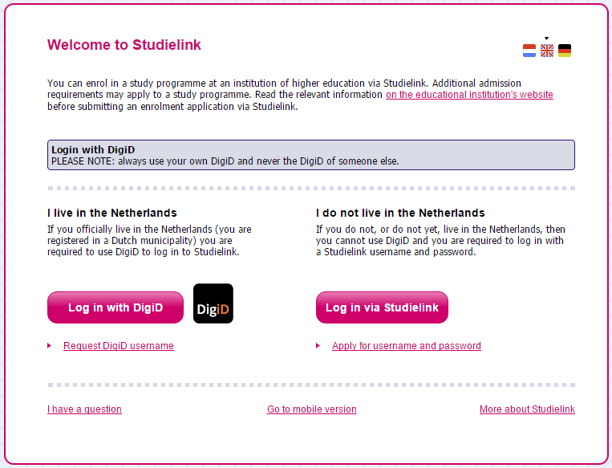
Studielink
Studielink allows you to independently arrange your enrolment and or re-enrolment at your institution of higher education online.
Only for Bachelor and Master
degrees
Exchange students apply via
their host institution

Slide 22
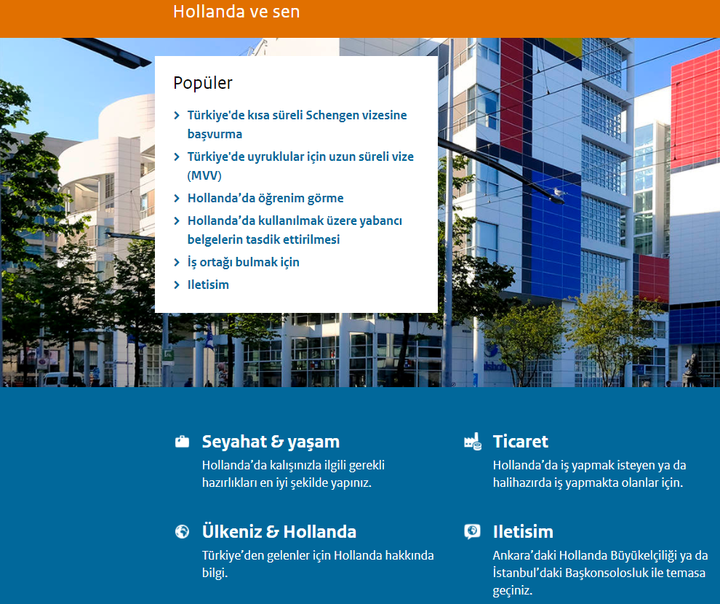
Visa & formalities
To stay longer than 90 days you need;
an entry visa (MVV)
residence permit (VVR)
Support of host institution
Schengen area
Application fee: €300
(subject to change)
www.hollandavesen.nl/seyahat-ve-yasam/

Slide 23
Health insurance
Everybody in the Netherlands must have insurance
for medical costs
Please inform at the international office of your host institution and check what type of insurance applies for you

Slide 24
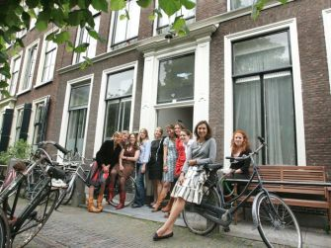
Housing / Accommodation
Options
In a student room: a shared house
On-campus
Cost of housing monthly
€ 300 - € 600 – depends on the city
Recommendations
Start looking for a room as soon as possible
Use the assistance of the institution
https://www.studyinholland.nl/practical-matters/housing

Slide 25
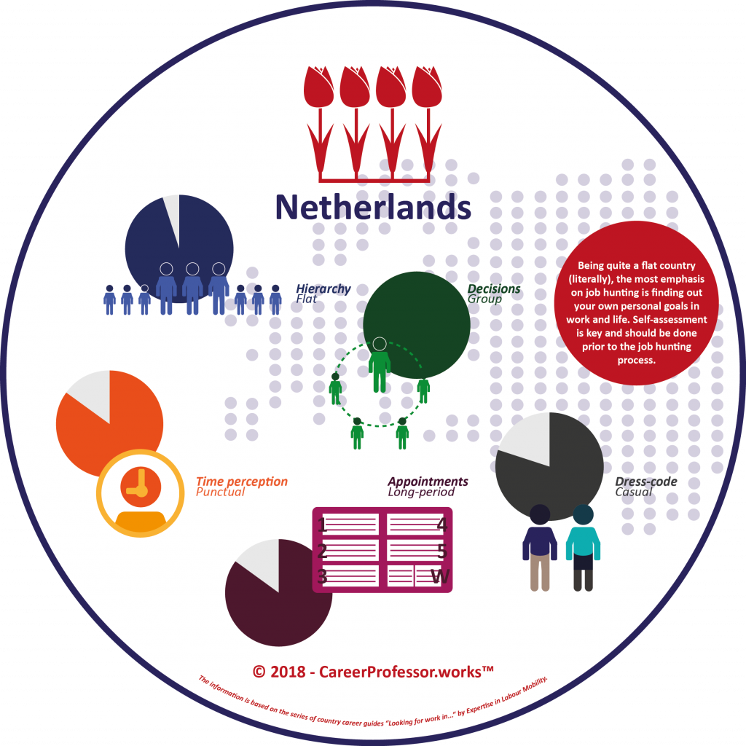
Working while studying
Work permit
Can I work while studying: YES!
Work permit required
Limited number of hours: maximum 16 hours a week
Work full time during summer months
Work after your studies: Orientation Year
Application within 3 years after graduation or finishing research
Application per degree
Top 200 world universities

Slide 26
Contact details YÖK – Denklik Birimi
Telefon: 0850 470 0 965 (0850 470 0 YÖK)
Adres: YÖK - Yükseköğretim Kurulu Başkanlığı
06539 Bilkent / ANKARA
E-posta: denklik@yok.gov.tr

Slide 27
Important links!
Neso Turkey: www.nesoturkey.org acts as a portal!
  Study in Holland: www.studyinholland.nl
  English taught study programmes: www.studyfinder.nl
  Scholarships: www.grantfinder.nl
  Studielink: www.studielink.nl

Slide 28
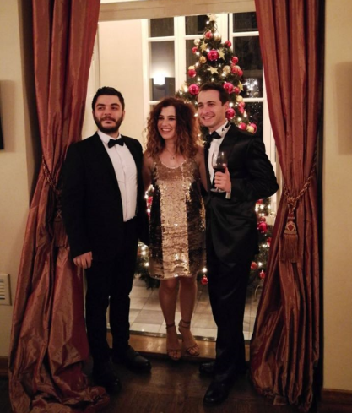
Your local office in Turkey
Nuffic Neso Turkey Team
Call Centre Hours
10:00 – 12:00
14:00 – 16:00
(weekdays)
Tel: +90 212 252 9712
Email: info@nesoturkey.org
Web: www.nesoturkey.org

